Slide 1
What is the Fed saying?
NLP & Topic Modeling FOMC Statements

Slide 2
The Federal Reserve is the central bank of the US.
FOMC = Federal Reserve committee that sets short -term interest rates. The basis for mortgages, student loans and credit card interest rates.
About 8 meetings a year.
Since 1994, they have released statements after their meetings which summarize their view of the economy and whether they will change rates.

Slide 4
The Data
176 FED statements from
1994 -2018 were scraped from federalreserve.gov

Slide 5
Process
176 Statements were broken down into 14,261 sentences.
CountVectorizer and Latent Dirichlet Allocation were used to derive 4 topics.

Slide 6
Sentences from Sep 17, 2001 Statement
The FOMC decided today to lower its target for the federal funds rate by 25 basis points to 1-3/4 percent…
Economic activity remains soft, with underlying inflation likely to edge lower from relatively modest levels. To be sure, weakness in demand shows signs of abating, but those signs are preliminary and tentative.

Slide 7
Although the necessary reallocation of resources to enhance security may restrain advances in productivity for a time, the long-term prospects…for the economy remain favorable…
The Committee continues to believe that…the risks are weighted mainly toward conditions that may generate economic weakness in the foreseeable future.

Slide 8
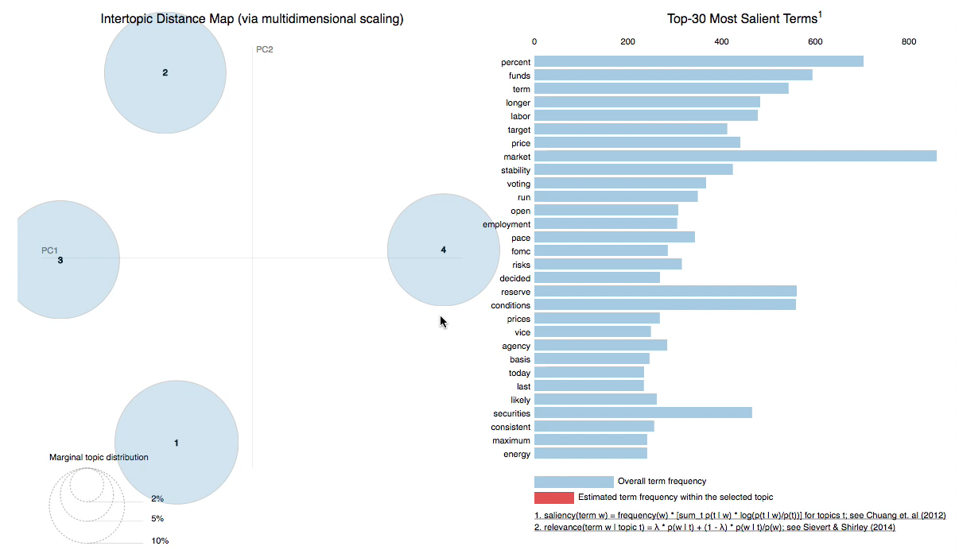

Slide 9
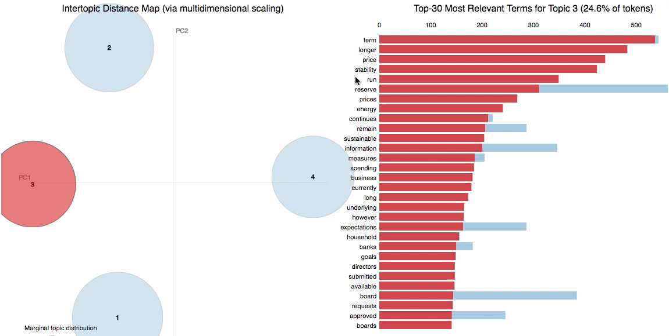

Slide 10
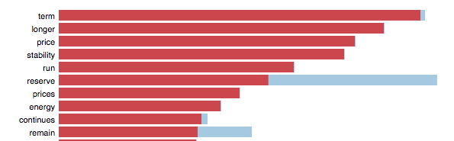
Topic 3.
Not much different from topics 1 & 2.

Slide 11
Topic 4
Percent funds target voting
Decided basis 25 increase

Slide 12
Percent funds target voting Decided basis 25 range
Lowered Rate in Sep 2011
The FOMC decided today to lower its target for the federal funds rate by 25 basis points to 1-3/4 percent
Raised Rates in December 2017
The Committee decided to raise the target range for the federal funds rate to 1-1/4 to 1‑1/2 percent.

Slide 13
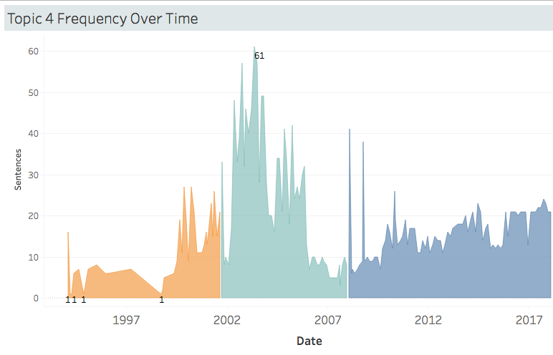

Slide 14
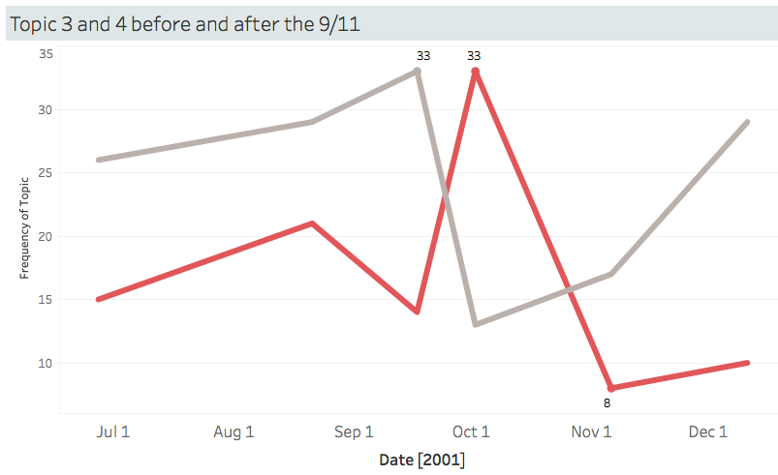
Topic 3
Topic 4

Slide 15
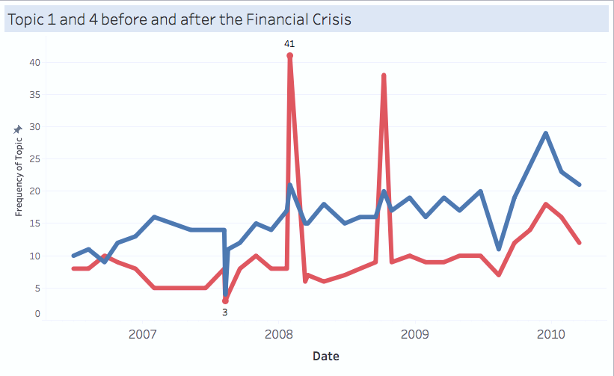
Topic 1
Topic 4

Slide 16
Conclusions
Other steps…
Topic 4 can be interpreted as the RATE CHANGE topic.
LDA can deliver when parameters are tuned properly and a given amount of domain knowledge can be applied.
Difficult to interpret much beyond that.
Model word frequency over time.
How vocabulary has changed with different Fed Reserve Chairmen.

Slide 17
Thanks Julia and Vinny
And classmates!!!

